Slide 1


Software as Data Structure
ITDK 2016
Author: Lorand Kedves, ST3BJ3
Supervisor: Dr. László Czúni
Date: 2016. 11. 09.
University of Pannonia
Department of Electrical Engineering and Information Systems
Notes:
In information systems, data and logic are equally stored as sequences of 0 and 1
When we think of software, we mean different coding languages, toolkits, platforms, standards…
What makes this difference critical?

Slide 2

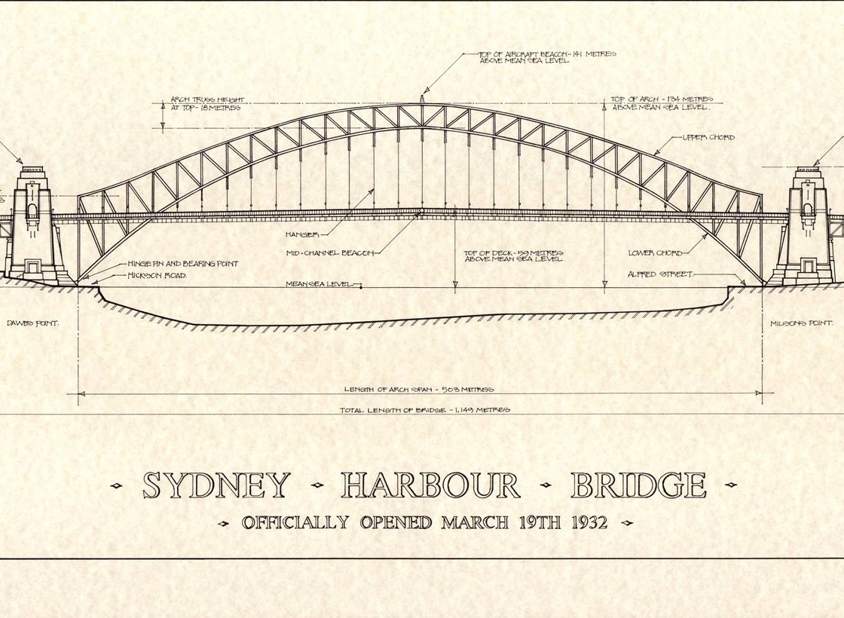
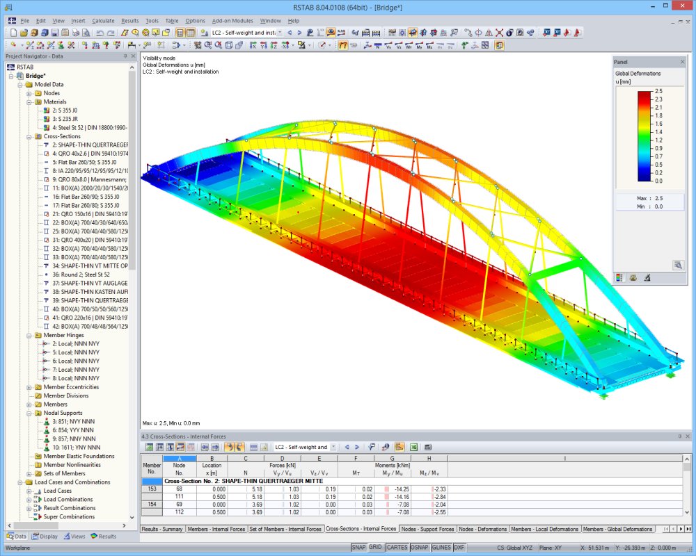
Data Structures and Layers
Data Structures and Layers
Layers in Informatics
Today Software is: Text!
Building Systems Today
Neumann Architecture – Dust Platform
Planning
Building
Running
DustCompact Toolkit
Application = Data Structure
Organic Building
History and Present
Evaluation
2 / 14
Engineering artifact
Data structures behind:
- Plans
- Physics, mathematics, materials: enable testing!
Objective, academic knowledge of centuries; global notation system
Independent layers, „dimension change”: operation above represented as data below

Slide 3

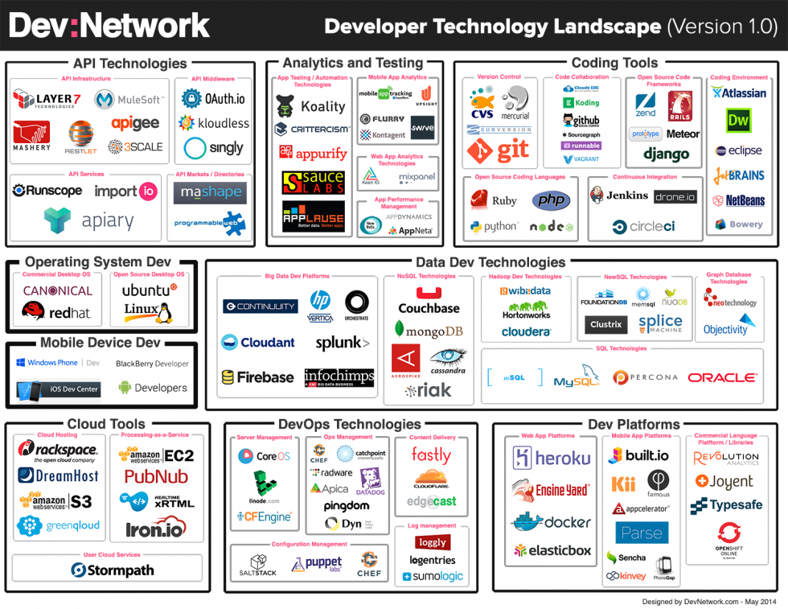
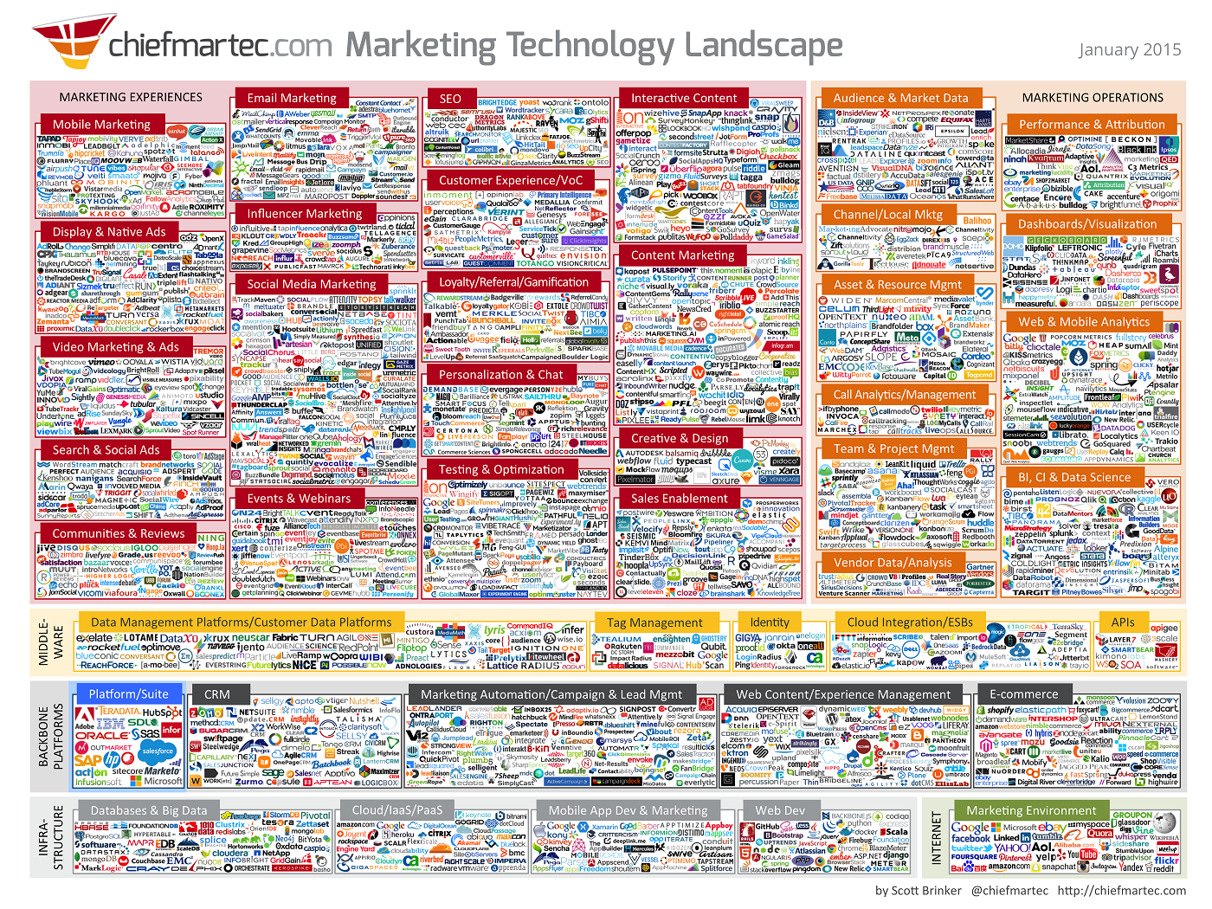
Layers in Informatics
Data Structures and Layers
Layers in Informatics
Today Software is: Text!
Building Systems Today
Neumann Architecture – Dust Platform
Planning
Building
Running
DustCompact Toolkit
Application = Data Structure
Organic Building
History and Present
Evaluation
3 / 14
Information system
„Data structures”:
- Implementation tools
- Business layer tools
„Newer is better” approach, incompatible notation systems based on business reasons
Interdependent toolkits, instead of isolated layers
„Too much of good” – but this is constant beta…

Slide 4
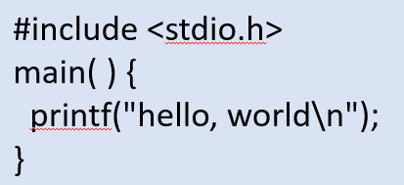
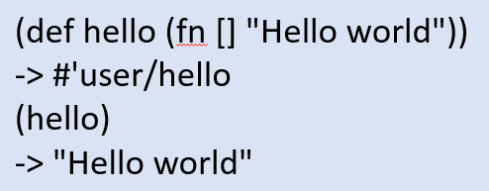
Today Software is: Text!
Application
Application
Data Structures and Layers
Layers in Informatics
Today Software is: Text!
Building Systems Today
Neumann Architecture – Dust Platform
Planning
Building
Running
DustCompact Toolkit
Application = Data Structure
Organic Building
History and Present
Evaluation
4 / 14
Message: „Hello, World!”
Command
C, 1974
Message: „Hello, World!”
Command
Printing component
Printing component
Clojure, 2007
Although the Neumann Architecture and engineering experience prove its importance, implemented software is not a data structure anymore, but weird plain text!
fn main() {
println!("Hello, world!");
}
Application, represented as an abstract data structure
Rust, 2015

Slide 5
Building Systems Today
Documentation
Planning „out of the system”
System structure in source code
Data Structures and Layers
Layers in Informatics
Today Software is: Text!
Building Systems Today
Neumann Architecture – Dust Platform
Planning
Building
Running
DustCompact Toolkit
Application = Data Structure
Organic Building
History and Present
Evaluation
5 / 14
System
Choosing the infrastructure
„represented thing” (OOP object)
… dictates implementation language and tools
Data
Covering the plans with code
Source language*
The infrastructure manages the data as we knew at creation, can’t adapt to changes
Operation
Running platform*
Environment
Infrastructure
Data structure
Planning
Building
Running

Slide 6
Neumann Architecture – Dust Platform
Data Structures and Layers
Layers in Informatics
Today Software is: Text!
Building Systems Today
Neumann Architecture – Dust Platform
Planning
Building
Running
DustCompact Toolkit
Application = Data Structure
Organic Building
History and Present
Evaluation
6 / 14
Software evolution calls for new representation
Neumann Architecture (abstracting electronics)
Data structures in the center
Independence from execution methods
Minimal, homogeneous, „matehmatical” components
Dust Platform (abstracting informatics)
Representation – same tools for data and services
Communication – representing messages
Execution – reacting code in context

Slide 7
Planning – homogeneous, „self supporting” tools
Data Structures and Layers
Layers in Informatics
Today Software is: Text!
Building Systems Today
Neumann Architecture – Dust Platform
Planning
Building
Running
DustCompact Toolkit
Application = Data Structure
Organic Building
History and Present
Evaluation
7 / 14
System
Representation
Existence – Entity
Data – Models
Behavior – Services
„Self supporting”
Plans are entity networks
Types and services are also entities
„Meta layer”
Type Entity*
Model*
Documentation Entity*
Entity
Service Entity*
Service*

Slide 8
Building – isolated data structures and implementation
Data Structures and Layers
Layers in Informatics
Today Software is: Text!
Building Systems Today
Neumann Architecture – Dust Platform
Planning
Building
Running
DustCompact Toolkit
Application = Data Structure
Organic Building
History and Present
Evaluation
8 / 14
Application
Execution envitonment
Terminology*
Module*
Implementation*
Code language*
Entities in structural and communication network
Initialization message array
Platform*

Slide 9
Running – external, adaptive engine
Data Structures and Layers
Layers in Informatics
Today Software is: Text!
Building Systems Today
Neumann Architecture – Dust Platform
Planning
Building
Running
DustCompact Toolkit
Application = Data Structure
Organic Building
History and Present
Evaluation
9 / 14
Running system (still data)
Dust runtime environment
Environment
Kernel initialization
Entity cloud
Platform booting
Application loading
Dust binaries
KERNEL messaging
data access
Launch messages
Custom binaries

Slide 10
DustCompact Toolkit
Data Structures and Layers
Layers in Informatics
Today Software is: Text!
Building Systems Today
Neumann Architecture – Dust Platform
Planning
Building
Running
DustCompact Toolkit
Application = Data Structure
Organic Building
History and Present
Evaluation
10 / 14
Dust Platform implementation in Java
Runtime environment
Data definition and management
Instantiate and call binaries
Building application
Modules
Integration: Poi (Excel), MVEL (Expression), MySQL (database)
Web environment: J2EE, Jetty, JavaScript middleware
Applications
Demos
Excel template manager
ERPort ETL web application

Slide 11
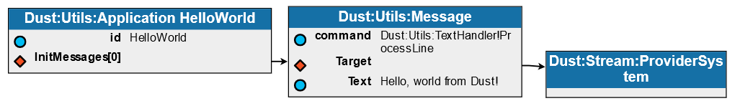
Application = Data Structure
Data Structures and Layers
Layers in Informatics
Today Software is: Text!
Building Systems Today
Neumann Architecture – Dust Platform
Planning
Building
Running
DustCompact Toolkit
Application = Data Structure
Organic Building
History and Present
Evaluation
11 / 14
Application
The software remains a data structure
The application is the entity network itself, displayed graphically here
The used JSON files are only a way to serialize the network
… like source codes are only serialized forms of the algorithms! (Neumann)
Message: „Hello, World!”
Command
Printing component
Hello, World! - DustCompact

Slide 12
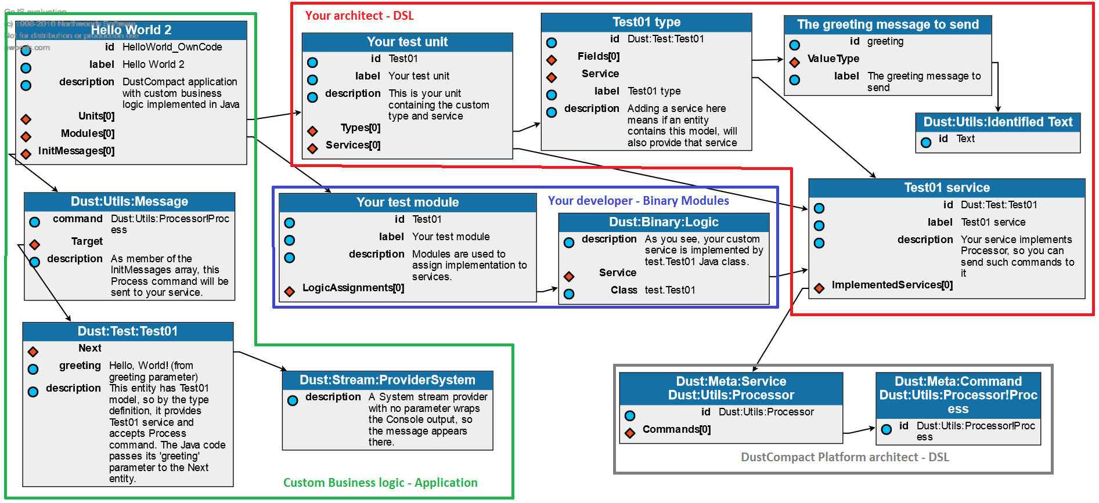
Organic Building
Data Structures and Layers
Layers in Informatics
Today Software is: Text!
Building Systems Today
Neumann Architecture – Dust Platform
Planning
Building
Running
DustCompact Toolkit
Application = Data Structure
Organic Building
History and Present
Evaluation
12 / 14
Hello, World! – custom language elements and binaries

Slide 13
History and Present
History
Plugin architectures – DataScope (2000, C++)
Adaptive, configurative systems – IIER (2004, Java)
„Big data” - Continental Release Monitoring (2014)
Configurative GUI – IIER (2004), KiBoard (2012, iOS)
„Self planning”, code generation – DustConstruct (2015)
DustCompact: ERPort – web ETL application
Document storage
Excel import with dynamic type management
Adaptive grid, property sheet, validation
Minimal amount of source code
Data Structures and Layers
Layers in Informatics
Today Software is: Text!
Building Systems Today
Neumann Architecture – Dust Platform
Planning
Building
Running
DustCompact Toolkit
Application = Data Structure
Organic Building
History and Present
Evaluation
13 / 14

Slide 14
Evaluation
Data Structures and Layers
Layers in Informatics
Today Software is: Text!
Building Systems Today
Neumann Architecture – Dust Platform
Planning
Building
Running
DustCompact Toolkit
Application = Data Structure
Organic Building
History and Present
Evaluation
14 / 14
Advantages
Efficiency
Flexibility
Share and reuse
Rapid development
Executable plans
Organic improvement
Risks
Dependency
Size
Learning curve
Performance
Resources
Transferability

Slide 15
Thank you for your attention!
Software as Data Structure ITDK 2016
Author: Lorand Kedves, ST3BJ3
Supervisor: Dr. László Czúni
Date: 2016. 11. 09.
University of Pannonia
Department of Electrical Engineering and Information Systems

